Slide 1


Auction Car Price Prediction
Ganesh Akhade
Kamlesh Vidhate
Prashant Karhale Akshay Tilekar (External Guide)
Center Coordinator
Presented by:

Slide 2
Introduction
Auction Car Price Prediction
Vehicle price prediction especially when the vehicle is used and not coming direct from the factory, is both a critical and important task. With increase in demand for used cars more and more vehicle buyers are finding alternatives of buying new cars.
There is a need of accurate price prediction mechanism for the used cars Prediction techniques of machine learning can be helpful in this regard.
It is commonly happening to buy old cars rather then buying a new car.

Slide 3
Auction Car Price Prediction
Objective
In this project aim is to use supervised machine learning algorithm, in that context we have to take the past data of cars that are sold in an auction, applying data cleansing techniques on that, also perform some EDA to extract useful features from data, also applying feature engineering aspects and build a model according to that using various algorithms and predict the car prices.
Institute for Advanced Computing and Software Development, Akurdi

Slide 4
Project Work Flow
Auction Car Price Prediction
Data Gathering
Studying the data
Data Cleaning
EDA
Feature Engineering
Model Building
Predection
Institute for Advanced Computing and Software Development, Akurdi

Slide 5
Data Preprocessing
Auction Car Price Prediction
Checking NULL values.
Removing NULL values as we have sufficient amount of data for prediction.
Checking duplicate value.
Checking redundancy of data.
Removing redundancy in the data.
Appling data normalization techniques and data scaling.
Institute for Advanced Computing and Software Development, Akurdi

Slide 6
Exploratory Data Analysis (EDA)
Auction Car Price Prediction
We performed EDA on the Car Auction dataset to understand the factors influencing the Auction of used car's. It was a large dataset containing about 558k rows. we have deleted the null values and irrelevant columns to get better understandings of the data.
In this analysis, we plotted some graphs to show the distribution of selling price according to different factors like Odometer, Year of the model and the Brands of the vehicle.
From this analysis, we could understand that, the factors like Odometer(the distance travelled by the vehicle), Brands of vehicle and Year of the model are mainly influencing the auction of used cars. Cars with lesser odometer are getting good selling price in the auction.

Slide 7
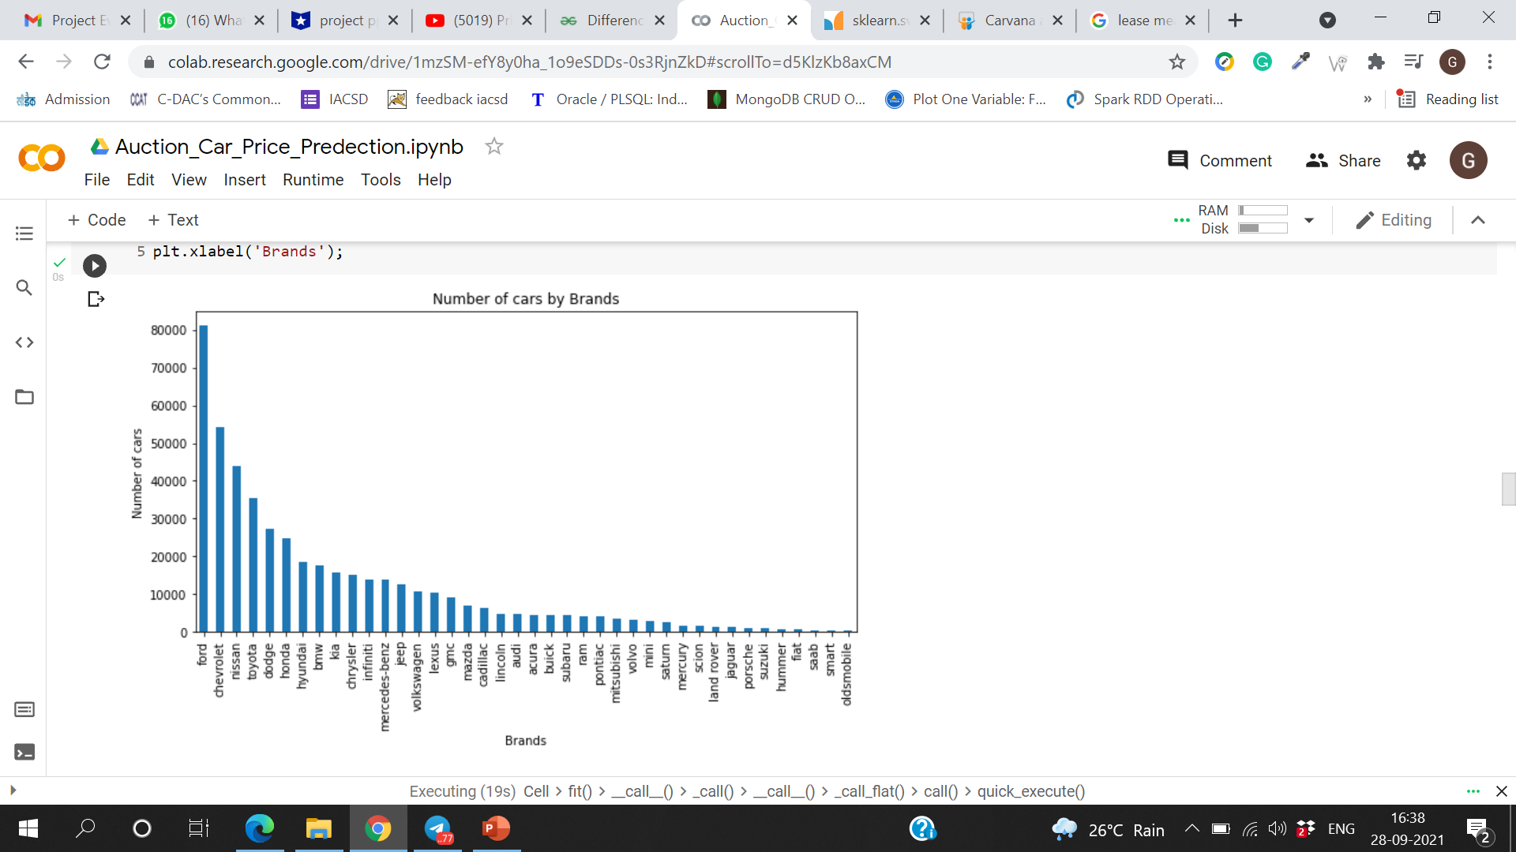
Exploratory Data Analysis (EDA)
Auction Car Price Prediction

Slide 8
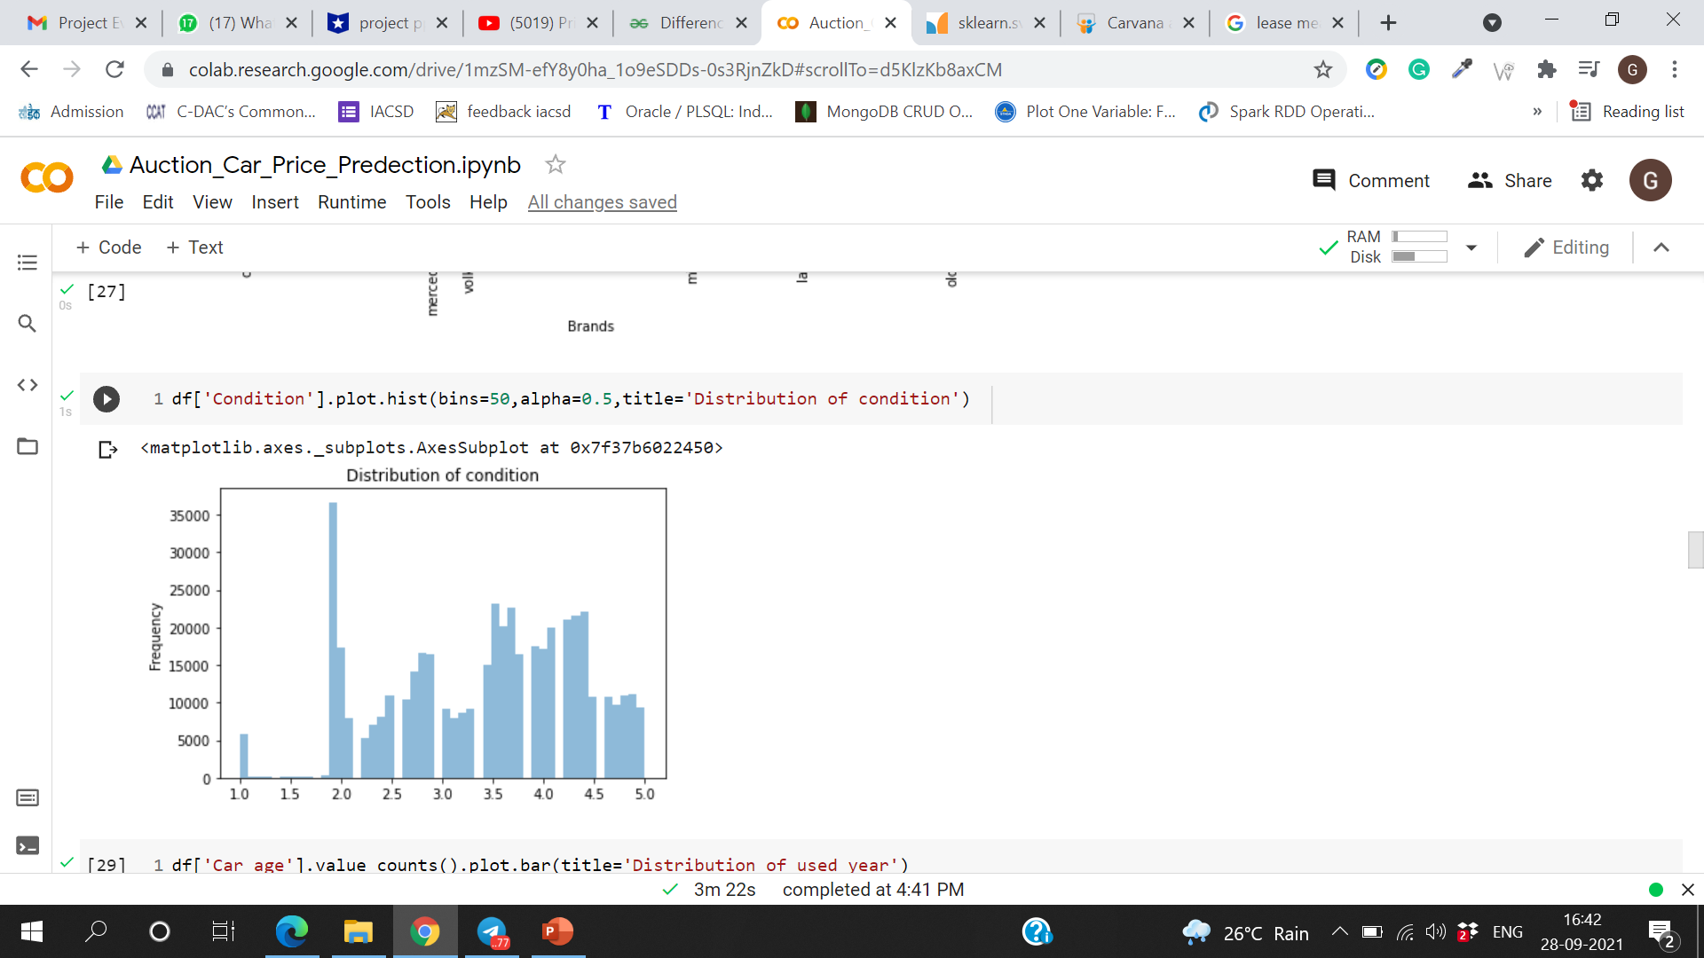
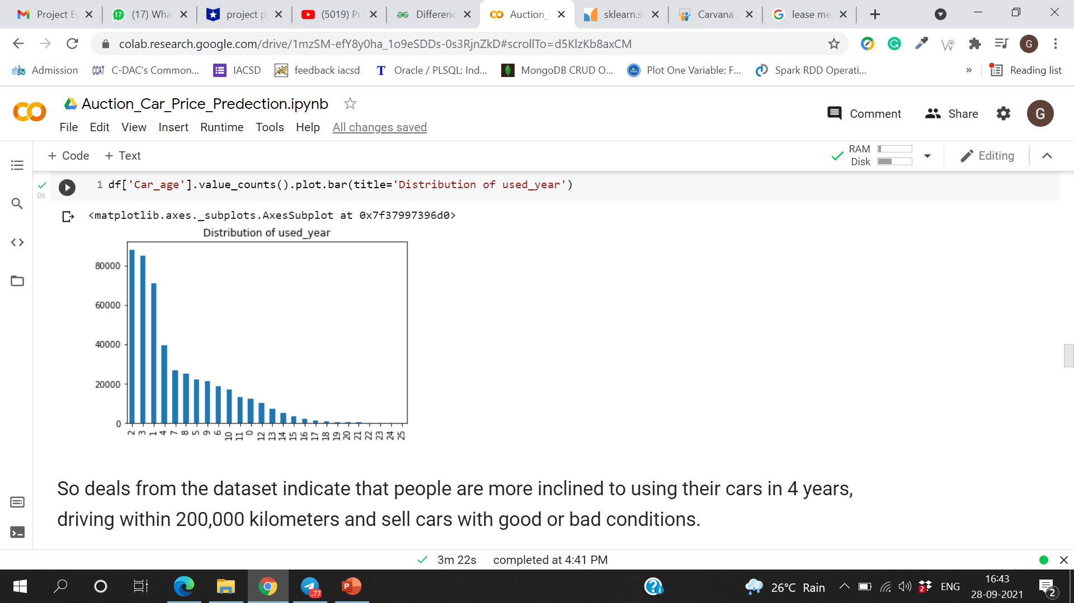
Exploratory Data Analysis (EDA)
Auction Car Price Prediction

Slide 9
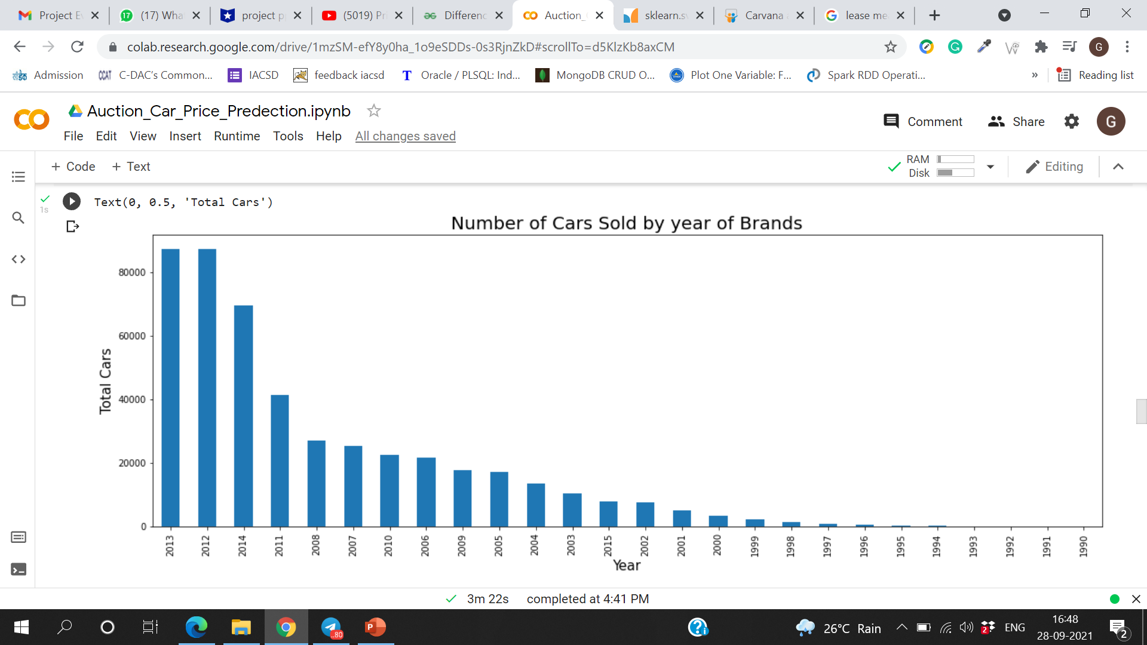
Exploratory Data Analysis (EDA)
Auction Car Price Prediction

Slide 10
Feature Engineering
Auction Car Price Prediction
Extracting feature from the available features.
Performing One-Hot-Encoding on categorical features.
Applying Principal Component Analysis (PCA) to obtain most important features towards dependent variable.

Slide 11
Model Building
Auction Car Price Prediction
Random Forest Regressor : ( r2 score – 0.9740 )
A random forest is a meta estimator that fits a number of classifying decision trees on various sub-samples of the dataset and uses averaging
to improve the predictive accuracy and control over-fitting.
Linear Regression : ( r2 score – 0.9750 )
Linear Regression fits a linear model with coefficients w = (w1, …, wp) to minimize the residual sum of squares between the observed targets in the dataset, and the targets predicted by the linear approximation.
Gradient Boosting Regressor : ( r2 score – 0.9771 )
GB builds an additive model in a forward stage-wise fashion; it allows for the optimization of arbitrary differentiable loss functions. In each stage a regression tree is fit on the negative gradient of the given loss function.
Extra Tree Regressor: ( r2 score – 0.9771 )
Extra Trees for short, is an ensemble machine learning algorithm. Specifically, it is an ensemble of decision trees and is related to other ensembles of decision trees algorithms such as bootstrap aggregation (bagging) and random forest.

Slide 12
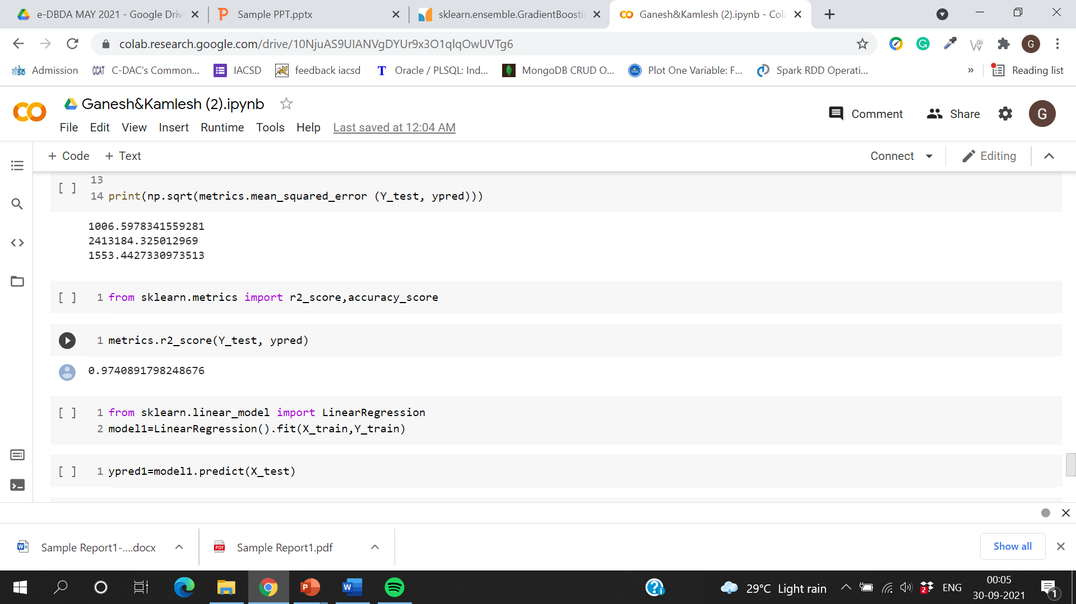
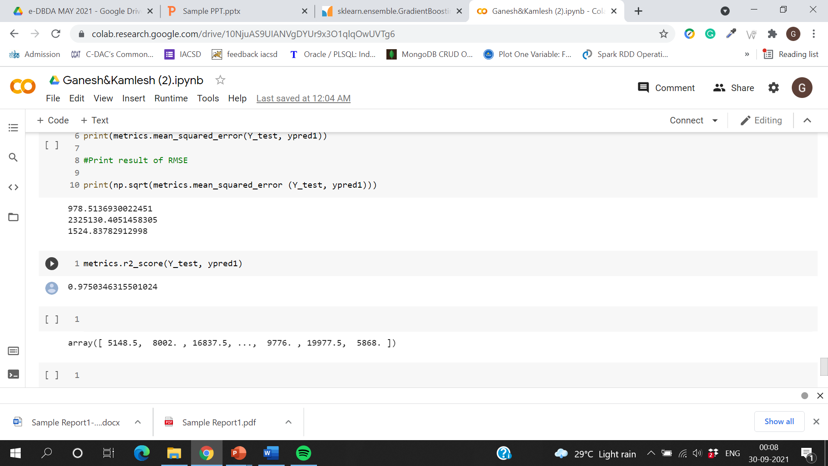
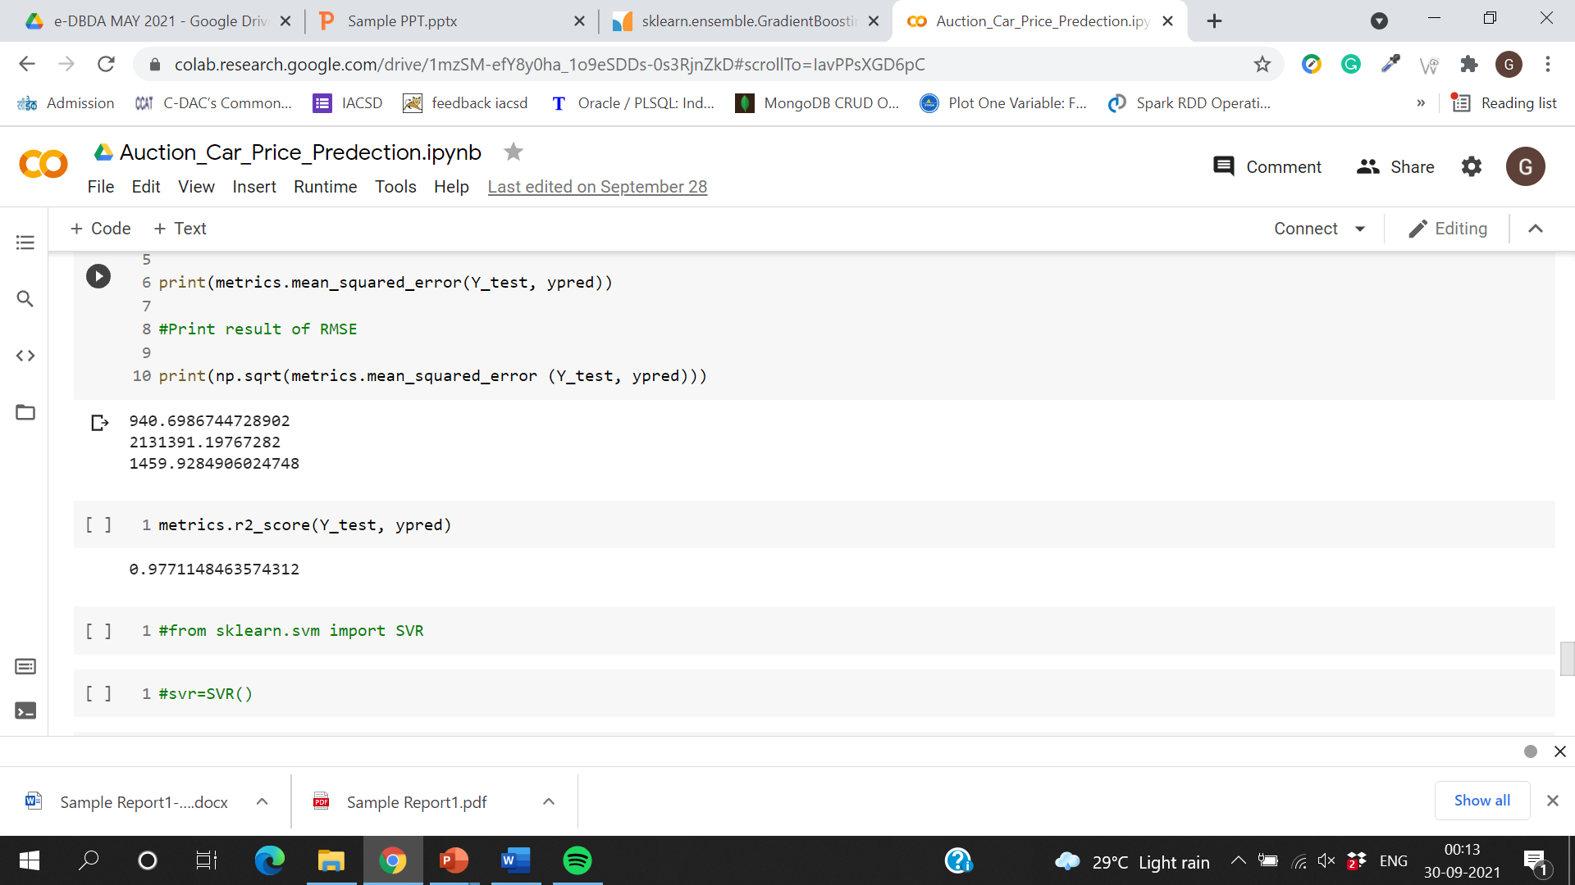
Accuracy
Auction Car Price Prediction
1.Random Forest Regressor:
2.Linear Regression:
3.Gradient Boosting Regressor:

Slide 13
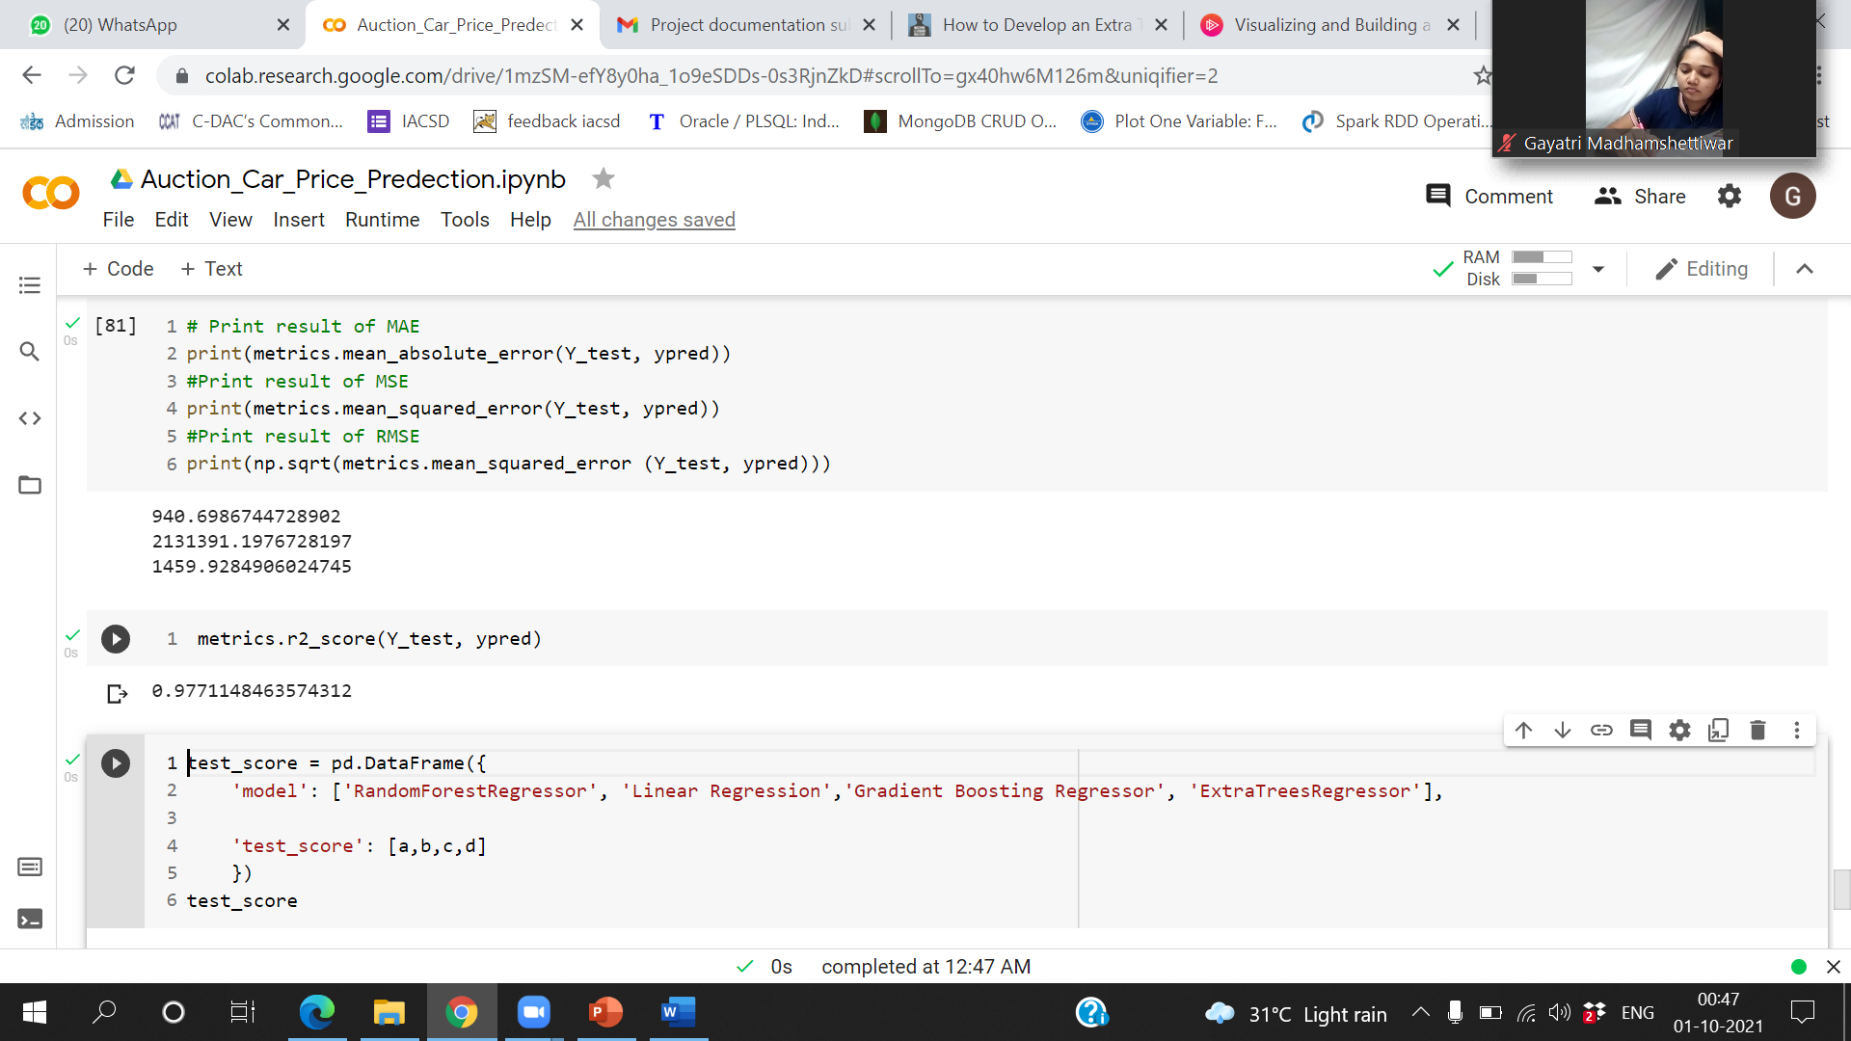
Accuracy
Auction Car Price Prediction
4. Extra Tree Regressor:

Slide 14
Conclusion
Auction Car Price Prediction
As we tested our data on various regression models we conclude that every model except SVR have nearly same R2 score but Extra Tree Regressor was exceptionally good as it gives R2 score 97.71% with less time than other algorithms.

Slide 15
Future Scope
Auction Car Price Prediction
For better performance, we plan to judiciously design deep learning network structures, use adaptive learning rates and train on clusters of data rather than the whole dataset. To correct for overfitting in Random Forest, different selections of features and number of trees will be tested to check for change in performance.

Slide 16
References
Auction Car Price Prediction
Dataset - https://www.kaggle.com/tunguz/used-car-auction-prices
Libraries - https://scikit-learn.org/stable/modules/ensemble.html
https://pandas.pydata.org/pandasdocs/stable/index.html
https://seaborn.pydata.org/
https://www.tensorflow.org/api_docs/python/tf/keras
Blogs - https://www.analyticsvidhya.com/machine-learning/
https://stackoverflow.com/questions/tagged/machine-learning

Slide 17
Thank You
Auction Car Price Prediction

